Slide 1
National Identification & Registration Bill 2020
Joint Select Committee Submission
Trevor Forrest
CEO, 876 Solutions
trevorforrest@876solutions.com
https://www.876solutions.com

Slide 2
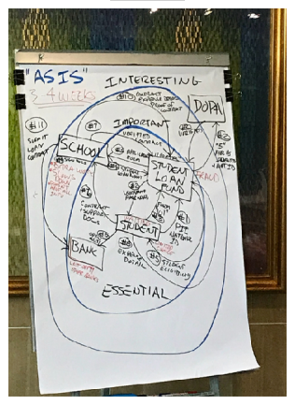
Current State of Citizen Identity & Services

Slide 3
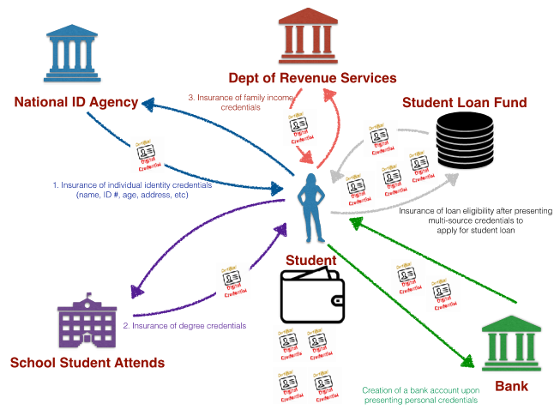
Future State of Citizen Identity & Services
Tax Administration
Hospital

Slide 4
Digital Identity & Self Sovereignty
10 Key Principles of Digital Sovereign Identity
Existence — Users must have an independent existence.
Control — Users must control their identities.
Access — Users must have access to their own data
Transparency — Systems and algorithms must be transparent.
Persistence — Identities must be long-lived.
Portability — Information and services about identity must be transportable
Interoperability — Identities should be as widely usable as possible.
Consent — Users must agree to the use of their identity.
Minimization — Disclosure of claims must be minimized
Protection — The rights of users must be protected

Slide 5
Identity Management Concepts
Dimensions of Identity
Validation Workflow
-------
Digital Sovereign Identity (DSI)
Data Anonymisation
Zero Knowledge Proof (ZKP).

Slide 6
Identity Management Systems
Dimensions of Identity

Slide 7
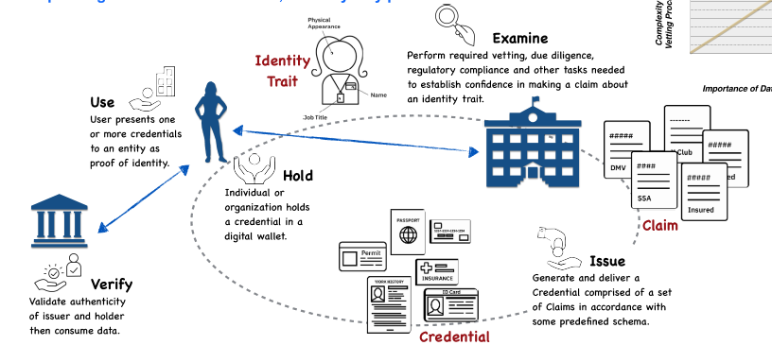
Identity Management Systems
Dimensions of Identity & Validation Flow

Slide 8
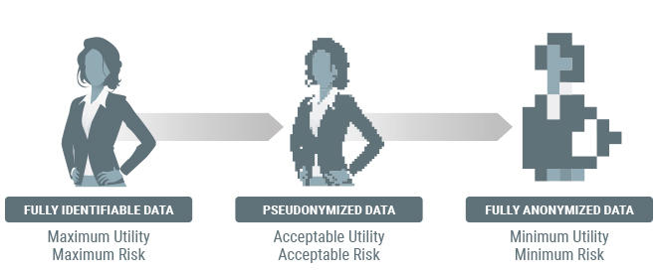
Data Anonymization
Data anonymization is a "process by which personal data is irreversibly altered in such a way that a data subject can no longer be identified directly or indirectly, either by the data controller alone or in collaboration with any other party."

Slide 9
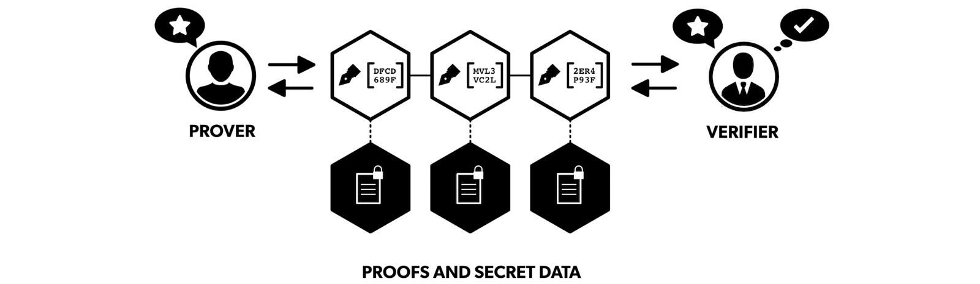
Zero Knowledge Proofs
“Is it possible to show that something is true without revealing the data that proves it?”
A Zero Knowledge Proof is a method by which one party (the prover) can prove to another party (the verifier) that they know a value x, without conveying any information apart from the fact that they know the value x.

Slide 10
General Comments & Concerns
Second Iteration of NIRA more Sober
Laudable additions in relation to data security
Over reliance on ID Card vs. NIN
Consider State Issuance of an e-Wallet/Digital Wallet or Smart Mobile ID
More Focus on Data Sovereignty and “Right to be Forgotten”
Potentially Restrictive Environment for Innovation

Slide 11
Detailed Comments & Concerns
Clauses 5, 7, 27(4), 28(2), 34, Schedule 1(1), Schedule 1(2)(6) and numerous other sections throughout the bill
The national Identification & Registration Authority reports to or has direct oversight by “The Minister” of the Authority’s associated portfolio Ministry.
Due consideration ought to be given to making the authority report directly to the parliament in a similar way to some of the existing independent commissions. This would be in an effort to increase citizen trust in the oversight of the entity
Clause 9 (4)
Suggest that the term anonymised and be added to this clause such that it reads something similar to “encrypted form that is not legible without decryption, and that is capable of being converted to an anonymised or legible form when required for the purposes of this act”.
Anonymisation important in instances where decryption of the data occurs this data must be sufficiently protected to ensure that the actual identity of a citizen is not made readily available outside of what is provided by the NIN

Slide 12
Detailed Comments & Concerns
Clauses 9(8) & 9(9) - Clauses speak to a person committing an offence “if the person, without lawful authority, wilfully….”
Is it that there is no offence if the person has lawful authority and accesses information when they have no need or business to?
What measures will be put in place to ensure that even if someone has lawful authority to access information they are ONLY allowed to do so when the specific need to access that information arises.
What measures will be put in place to ensure that the OWNER of this information, the citizen is immediately notified when their data is accessed, especially in scenarios when this may occur without their prior consent.

Slide 13
Detailed Comments & Concerns
Clause 11(1)(vii) - This clause refers to the collection of the “principal place of residence & other places of residence”.
NIDS Team proposes use of “Google Plus Codes” as one of the methods to be used for validation/verification of the citizen’s place of residence when due consideration is given to the varied living scenarios of our citizens.
Caution should be exercised. Based on how these technologies work and how they may be perceived, it could open the spectre of citizen privacy and mass surveillance. Could impact enrolment and more importantly the trust and ultimate success of the National ID System

Slide 14
Detailed Comments & Concerns
Clause 11(b)(iii) – This clause is in reference to biometric information collected for the individual, specifically the “manual signature, in the case of an individual who is over 18 years of age or older”.
Why does a manual signature qualify as biometric information is this case.
Why is manual signature needed or relevant especially when something more unique in the form of the NIN will ultimately be created which negates the need for a signature. (consideration is also given to the fact that a fingerprint or a facial image is part of biometric data requested)

Slide 15
Detailed Comments & Concerns
Clause 14(1)(b) – This clause speaks to an individual’s request for cancellation of enrolment. Pursuant to the definitions of “enrolled individual” & “enrolment” in the bill
Clarity needed as to whether the individual’s data is fully purged from the National ID Databases
Not clear as to the technical process and subsequent evidence employed and provided respectively to guarantee to the individual that their request for cancellation of enrolment has occurred
Not (technically) clear as to what actually happens when a person who previously requested enrolled cancellation seeks enrolment at a later date.
Given the nature of how a NIN is created, how/if an individual would/could regain their original NIN if a request to cancel enrolment should effectively remove ALL of their information from the national ID database. Note 15(2)(b) and (c) states that the NIN is permanently assigned to the enrolled individual and will not be assigned or re-assigned to another individual during the lifetime and after the death of the original assignee.

Slide 16
Detailed Comments & Concerns
The National ID Card – Sections 16, 17 18 & 19
National ID Card is being touted as a “means of proving that individual’s identity” or “as a means of facilitating transactions between that individual and any other party, where agreed between that individual and the other party”.
excessive dependence on the issuance and use of the National ID card as an instrument of validation without supporting infrastructure.
Possibility of fraud and information leakage based on excessive dependency on the ID Card
There should be tighter dependence on the NIN itself and supporting mechanisms to facilitate secure validation using zero knowledge proofs in lieu of a physical ID instrument
Expiration regime that is imposed on the ID card itself which is tied to 3 defined age brackets. This would seem to imply that there is something linking and individual’s age to the validity of the ID card

Slide 17
Detailed Comments & Concerns
Disclosure of Identity Information - Section (24)
24(5) – Seeking clarity on precisely how and to whom information in this clause will be provided to. Details as to the process by which information is accessed supplied are not clear. It is also unclear as to the measures that will be employed to demonstrate that requested data will not be altered post collection.
24(7)(b), 24(8) - The process outlined is insufficient to guarantee proper security and privacy of citizen data and a citizen’s right to be forgotten.
The provision that entitles an “individual and his attorney-at-law are entitled to be present to witness the destruction” of digitally stored/collected information is no guarantee that the information is actually purged
Reference is made to a similar data/information collection process that is outlined in considerably more detail in the Cybercrimes Act (Sections 16,17,19). This level of detail should be applied to data collection methods this bill as well,

Slide 18
Thank You
Trevor Forrest
CEO, 876 Solutions
trevorforrest@876solutions.com
https://www.876solutions.com

